Slide 1

Image Processing in R
OPIM-5503
Data Analytics using R
Team-smaRt
Project-1
De-Noising Dirty Documents
Deepak Sisodia
Mir Akram Ali Yadullahi
Harsha Chandar
Pranav Sachdev
Shaik Shaik

Slide 2

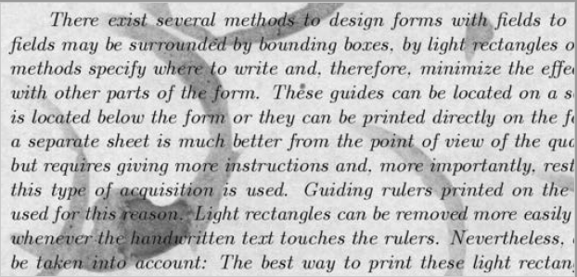
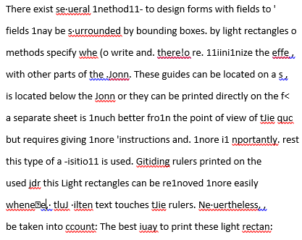
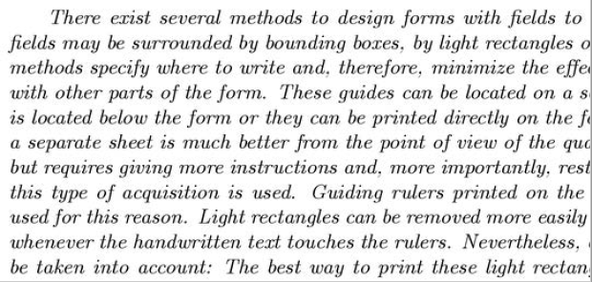
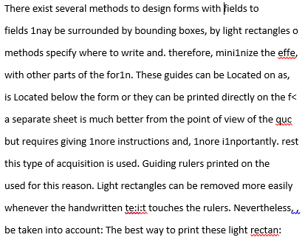
Introduction
OCR – Optical Character Recognition
Technique for converting printed text into machine-encoded text.
Text Image
OCR Output
Noisy
Image
Clean
Image
Introduction
Edge Detection
Median Filtering
Feature Engineering
Ensemble
Adaptive Thresholding

Slide 3
Objective
Using image processing and machine learning approaches create a predictive algorithm to clean up the noisy images of text
Noisy Image
Clean Image
Business Use Case
Lot of old and fragile documents can be digitized in a readable format.
Will improve OCR technique in accurately converting text image to live text.
Introduction
Edge Detection
Median Filtering
Feature Engineering
Ensemble
Adaptive Thresholding

Slide 4

Data set
Dirty images
Clean images
Grayscale images
8 bit images
Contain Noise
B&W images
1 bit images
No Noise
Introduction
Edge Detection
Median Filtering
Feature Engineering
Ensemble
Adaptive Thresholding

Slide 5
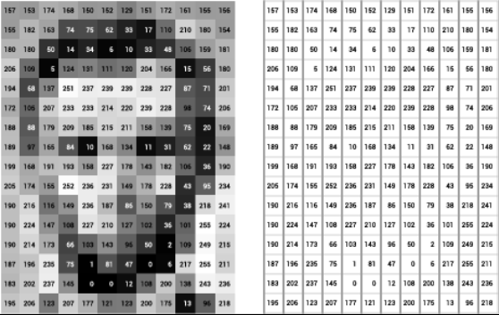
Approach
features
Input (x)
h₁(x)
h₂(x) …
h_{n}(x)
Output (y)
157
153
..
155
156
155
182
..
180
154
…
…
…
196
206
..
96
218
1
0
..
1
1
1
1
..
1
1
…
…
…
1
1
..
0
1
1
1
..
1
0
1
1
..
1
1
…
…
…
1
1
..
0
1
1
1
..
1
1
1
1
..
1
0
…
…
…
1
1
..
1
1
1
0
..
1
1
1
1
..
1
0
…
…
…
1
1
..
0
1
Step1 : Use image processing techniques to create features – h₁(x), h₂(x)...
Step 2: Use machine learning techniques to find relationship b/w y and input variables
y = f(x, h₁(x), h₂(x)……., h_{n}(x)) + e
Introduction
Edge Detection
Median Filtering
Feature Engineering
Ensemble
Adaptive Thresholding

Slide 6
Edge Detection and Morphology

Slide 7
Image Processing Technique 1: Edge Detection and Morphology
Edge Detection
Dilation
Erosion
Introduction
Edge Detection
Median Filtering
Feature Engineering
Ensemble
Adaptive Thresholding

Slide 8
Motivation
Input Character
Edge-detected Output
Pixel Dilation Output
Pixel Erosion Output
Input Noise (Stain)
Edge-detected Output
Pixel Dilation Output
Pixel Erosion Output
Introduction
Edge Detection
Median Filtering
Feature Engineering
Ensemble
Adaptive Thresholding

Slide 9
Algorithms Used
Edge Detection Algorithm
Used biOps package
imgCanny() function does edge detection using the Canny algorithm
Pixel Dilation
Created a function pixelDilation()
Pixel Erosion
Created a function pixelErosion()
Introduction
Edge Detection
Median Filtering
Feature Engineering
Ensemble
Adaptive Thresholding

Slide 10
Pixel Dilation Algorithm
XOR
SUM
If Sum > 0 { pixel = 0}
Sum = 2
Introduction
Edge Detection
Median Filtering
Feature Engineering
Ensemble
Adaptive Thresholding

Slide 11
Pixel Erosion Algorithm
XOR
SUM
If Sum > 0 { pixel = 1}
Sum = 4
Introduction
Edge Detection
Median Filtering
Feature Engineering
Ensemble
Adaptive Thresholding

Slide 12
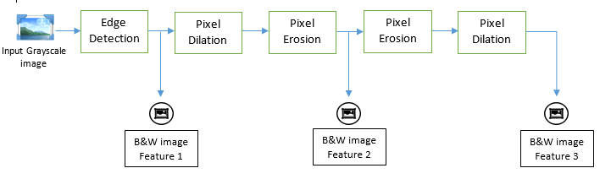
End-to-End Block Diagram
Video Demo
Introduction
Edge Detection
Median Filtering
Feature Engineering
Ensemble
Adaptive Thresholding

Slide 13
Adaptive Thresholding

Slide 14
Adaptive Thresholding
Global thresholding works if background is relatively uniform
Partition the original image into several sub images and utilize global thresholding techniques for each sub image
Adaptive Thresholding technique | R package (function)
Empirical Bayes thresholding | EbayesThresh (ebayesthresh)
Tree based thresholding | treethresh (treethresh)
wavelet thresholding | treethresh (threshold)
Local adaptive | EBImage (thresh)
Introduction
Edge Detection
Median Filtering
Feature Engineering
Ensemble
Adaptive Thresholding

Slide 15
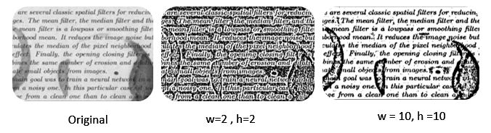
Adaptive Thresholding
thresh(x, w=5, h=5, offset=0.01)
x: Image object,
w, h: width and height of moving rectangular window.
Offset: Thresholding object from the average value
Introduction
Edge Detection
Median Filtering
Feature Engineering
Ensemble
Adaptive Thresholding

Slide 16
Median Filtering

Slide 17


Median Filter Implementation
Nonlinear digital filtering technique, often used to remove noise
An image filter that replaces a pixel with the median value of the pixels surrounding it
This technique wipes out small features, but maintains broad features
The resultant image is the ‘background’ of the image
Introduction
Edge Detection
Median Filtering
Feature Engineering
Ensemble
Adaptive Thresholding

Slide 18
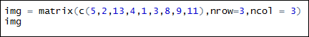
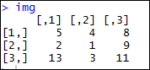
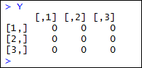
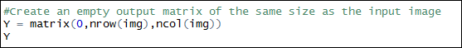
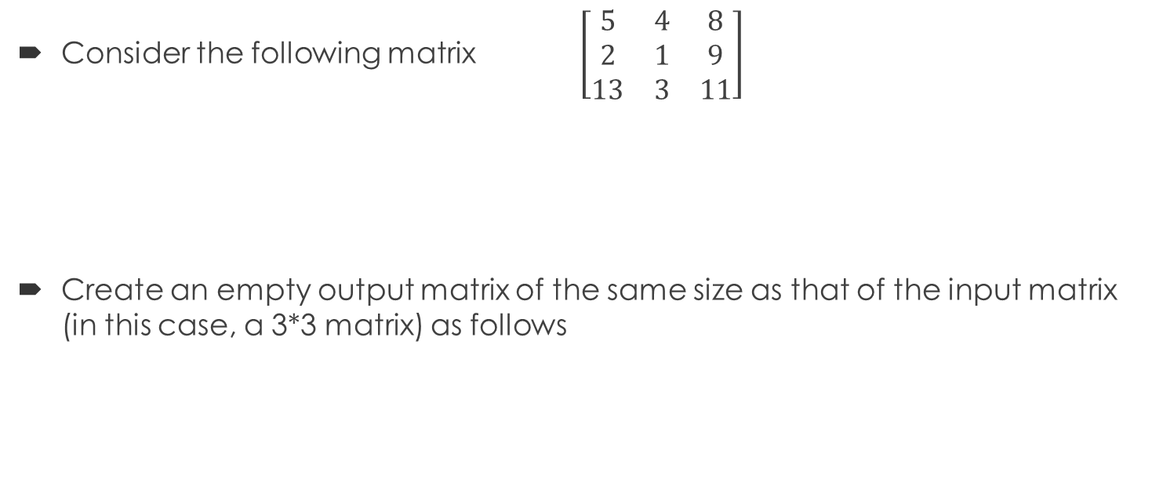
2-D Median Filter Algorithm
Consider the following matrix $\left[\begin{matrix}5 & 4 & 8 \\ 2 & 1 & 9 \\ 13 & 3 & 11\end{matrix}\right]$
Create an empty output matrix of the same size as that of the input matrix (in this case, a 3*3 matrix) as follows
Introduction
Edge Detection
Median Filtering
Feature Engineering
Ensemble
Adaptive Thresholding

Slide 19
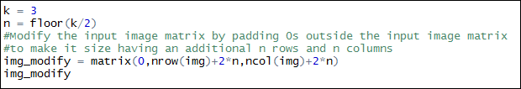
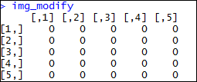
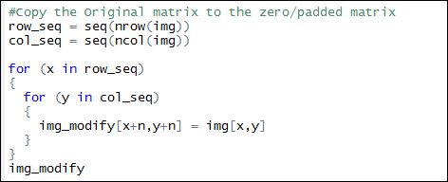
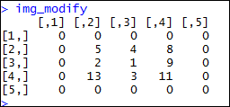
2-D Median Filter Algorithm
Pad the input matrix with zeros on all sides (based on the median filter width)
Place the input matrix (img), in the center of this newly created padded matrix as follows
Introduction
Edge Detection
Median Filtering
Feature Engineering
Ensemble
Adaptive Thresholding

Slide 20
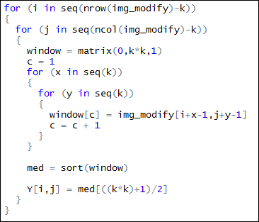
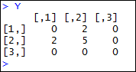
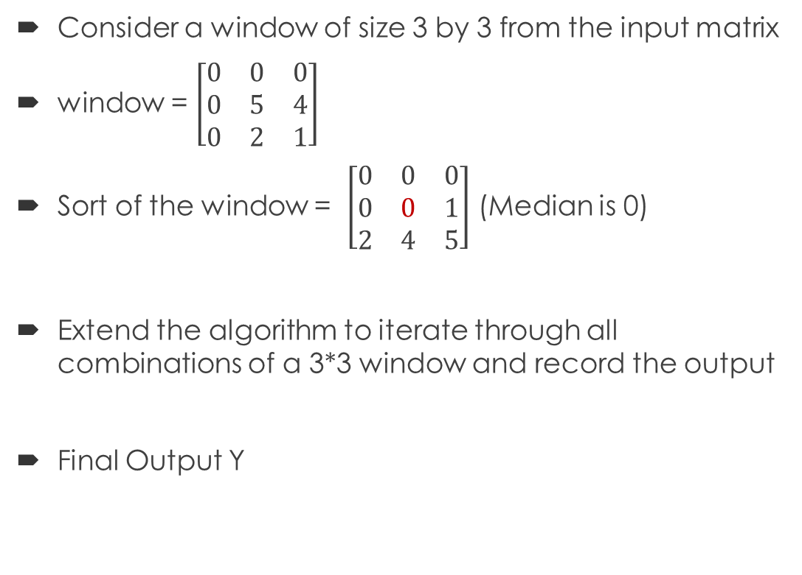
2-D Median Filter Algorithm
Consider a window of size 3 by 3 from the input matrix
window = $\left[\begin{matrix}0 & 0 & 0 \\ 0 & 5 & 4 \\ 0 & 2 & 1\end{matrix}\right]$
Sort of the window = $\left[\begin{matrix}0 & 0 & 0 \\ 0 & 0 & 1 \\ 2 & 4 & 5\end{matrix}\right]$ (Median is 0)
Extend the algorithm to iterate through all combinations of a 3*3 window and record the output
Final Output Y
Introduction
Edge Detection
Median Filtering
Feature Engineering
Ensemble
Adaptive Thresholding

Slide 21
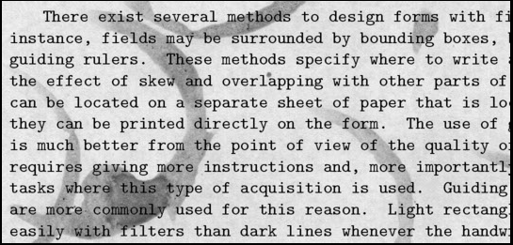
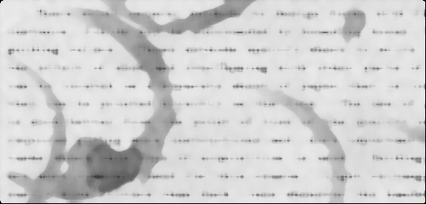
Median Filter – Image Processing
Input Image (with noise) Background Image (Applying the median filter – window size of 9)
Median Filter
Introduction
Edge Detection
Median Filtering
Feature Engineering
Ensemble
Adaptive Thresholding

Slide 22
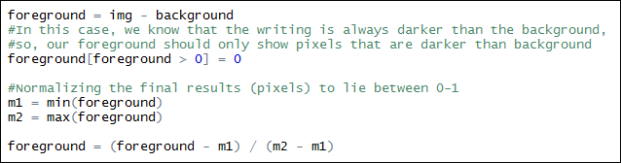
Extract the foreground from the background
Subtract the background from the original image and normalize the output image to have values between [0 1]
Introduction
Edge Detection
Median Filtering
Feature Engineering
Ensemble
Adaptive Thresholding

Slide 23
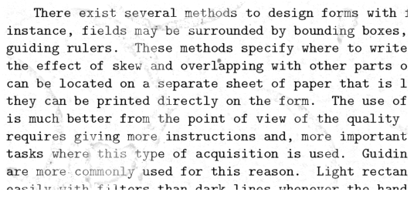
Processed Image
Input Image (with noise) Cleansed Image
Introduction
Edge Detection
Median Filtering
Feature Engineering
Ensemble
Adaptive Thresholding

Slide 24
Identifying gaps between lines of text

Slide 25
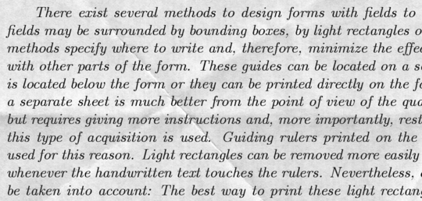
The image with noise
26
Line of sentence
Blank spaces
Background
Introduction
Edge Detection
Median Filtering
Feature Engineering
Ensemble
Adaptive Thresholding

Slide 26
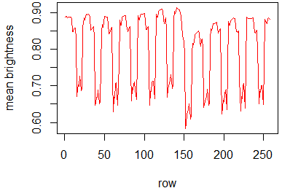
Identifying mean pixel value for each row
27
Due to noise
Pixel value = 1 (brightest)
Pixel value = 0 (darkest)
Rows where sentences are available
Gap / Background
Introduction
Edge Detection
Median Filtering
Feature Engineering
Ensemble
Adaptive Thresholding

Slide 27
Approach
Image with noise
K-Means Clustering
Imputed pixel values
K-Means clustering:
Cluster size: 2
Lower cluster: Lower pixel values
Upper cluster: Higher pixel values
Introduction
Edge Detection
Median Filtering
Feature Engineering
Ensemble
Adaptive Thresholding

Slide 28
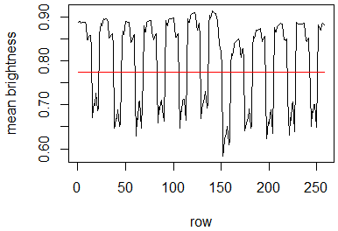
Identifying cutoff
29
Mean of (Highest value of lower cluster) AND (Lowest value of upper cluster)
Cutoff =
Cutoff
Introduction
Edge Detection
Median Filtering
Feature Engineering
Ensemble
Adaptive Thresholding

Slide 29
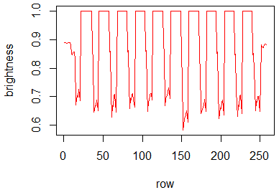
Imputing background
30
Introduction
Edge Detection
Median Filtering
Feature Engineering
Ensemble
Adaptive Thresholding

Slide 30

Plotting the skeleton – determining the gaps
Introduction
Edge Detection
Median Filtering
Feature Engineering
Ensemble
Adaptive Thresholding

Slide 31
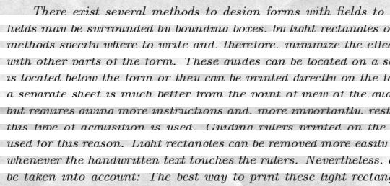
Final image
+
Introduction
Edge Detection
Median Filtering
Feature Engineering
Ensemble
Adaptive Thresholding

Slide 32
Final Image
Introduction
Edge Detection
Median Filtering
Feature Engineering
Ensemble
Adaptive Thresholding

Slide 33
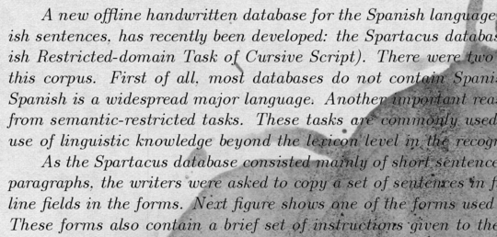
The image with noise
34
Line of sentence
Blank spaces
Background
Introduction
Edge Detection
Median Filtering
Feature Engineering
Ensemble
Adaptive Thresholding

Slide 34
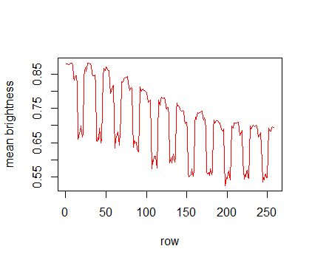
Identifying mean pixel value for each row
35
Due to noise
Gap / Background
Rows where sentences are available

Slide 35
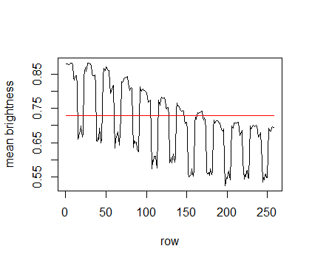
Identifying cutoff
36
Mean of (Highest value of lower cluster) AND (Lowest value of upper cluster)
Cutoff =
Cutoff

Slide 36
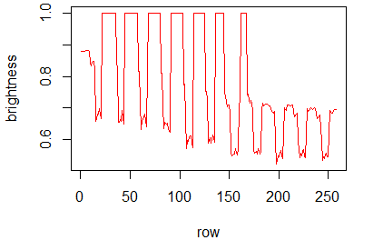
Imputing background
Introduction
Edge Detection
Median Filtering
Feature Engineering
Ensemble
Adaptive Thresholding

Slide 37
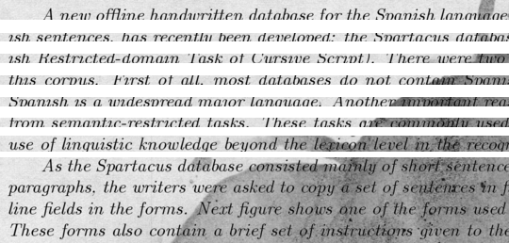
Final Image
Introduction
Edge Detection
Median Filtering
Feature Engineering
Ensemble
Adaptive Thresholding

Slide 38
Ensembling the results of different techniques - XGBoost

Slide 39
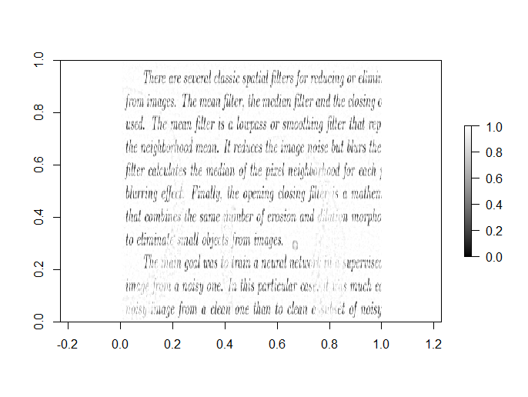
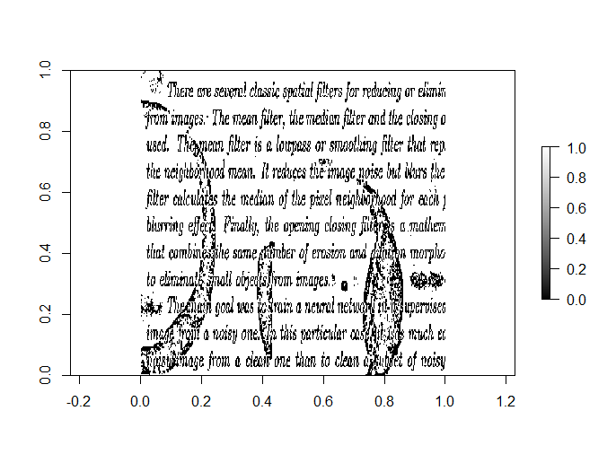
Individual Image Cleaning Algorithms Might Not Produce Optimum Results
Output from a Median Filter
Output from a Adaptive Thresholding
Introduction
Edge Detection
Median Filtering
Feature Engineering
Ensemble
Adaptive Thresholding
Notes:
Each of the algorithms we had just seen have their advantages and disadvantages
Median filter – noise removal but faded lines
Adaptive Thresholding – clear lines but the noise is still there

Slide 40
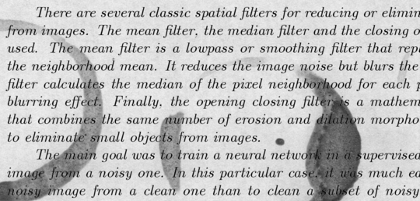
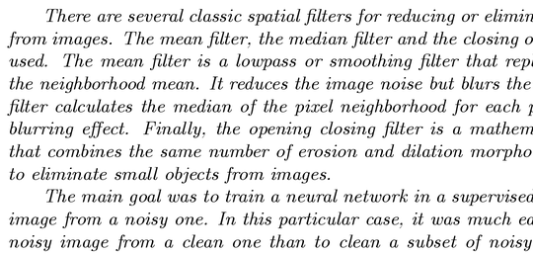
Process
Predictors
Median Filter
Model
Target
Input
XGBoost
Edge Detection
Adaptive Thresholding
Featurization
Introduction
Edge Detection
Median Filtering
Feature Engineering
Ensemble
Adaptive Thresholding

Slide 41
Gradient Boosting
A sequence of weak learners are used to produce more powerful predictions
Later models focus on learning errors better
Model 1
f(x)
Model 2
h(x)
Model n
k(x)
Residual
Introduction
Edge Detection
Median Filtering
Feature Engineering
Ensemble
Adaptive Thresholding

Slide 42
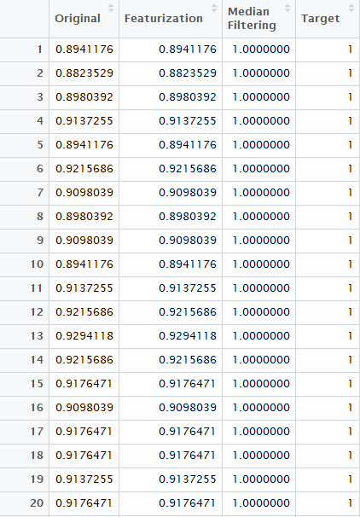
Algorithm
For each image in the data, do:
Read dirty image & and convert it into a one column matrix
Read clean image & convert it into a one column matrix
Apply feature detection filter & convert the cleaned image into a one column matrix
Apply median filtering & convert the cleaned image into a one column matrix
Column bind all these features
Append it to the dataframe containing these features for the previous images
Introduction
Edge Detection
Median Filtering
Feature Engineering
Ensemble
Adaptive Thresholding

Slide 43
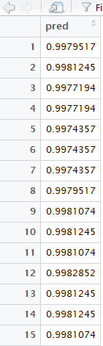
Algorithm contd...
Convert the data into a dense matrix with label being the cleaned image
Using cross validation, determine the optimum number of rounds for the xgboost model
Create the model with RMSE as the evaluation parameter
Predict for test images using this model
Take a randomly selected sample from the data(250000 rows were selected)
Convert the result into a matrix of the same dimensions as the original image
Introduction
Edge Detection
Median Filtering
Feature Engineering
Ensemble
Adaptive Thresholding

Slide 44
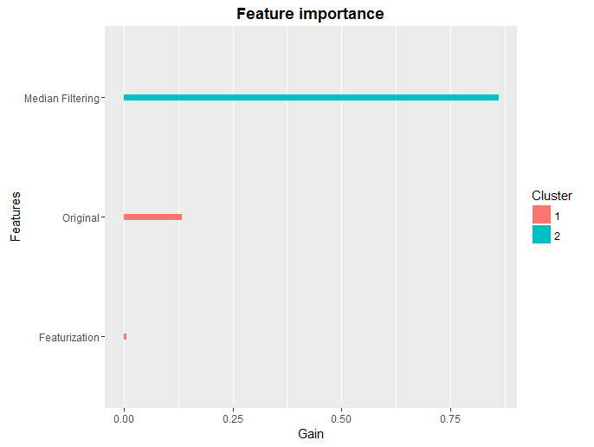
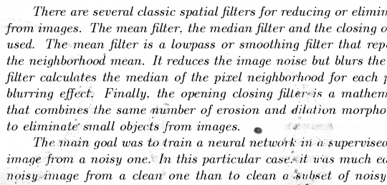
Conclusion
RMSE:
Training: 0.029384
Test: 0.032019
Introduction
Edge Detection
Median Filtering
Feature Engineering
Ensemble
Adaptive Thresholding

Slide 45


